Slide 1

Prediction of Employability for Graduates using Ensemble learning
SRM INSTITUTE OF SCIENCE AND TECHNOLOGY
SCHOOL OF COMPUTING
DEPARTMENT OF COMPUTING TECHNOLOGIES
18CSP107L / 18CSP108L - MINOR PROJECT / INTERNSHIP
Batch ID:
Student 1 Reg. No:RA19110030101252
Student 1 Name:Aakash Pandey
Student 2 Reg. No:RA1911003010225
Student 2 Name:Sriharsha Itha
Guide name: Abhirami G
Designation: Department: CTECH

Slide 2
Abstract
Nowadays, Graduates' employability is a major concern for the universities, and predicting their employability can help take timely actions to increase the institutional placement ratio
We predict the placement status of a student based on various student attributes using Logistic regression algorithm.
Knowing weaknesses before appearing can help students work in areas that they need to improve to best match the company's skillset.

Slide 3
This system predicts if a student would be placed or not based on the student’s qualifications, historical data, and experience. This predictor uses a machine-learning algorithm to give the result.
The algorithm used is logistic regression. Logistic regression is basically a supervised classification algorithm.
In a classification problem, the target variable(or output), y, can take only discrete values for given set of features(or inputs), X.
Dataset, it contains the secondary school percentage, higher secondary school percentage, degree percentage, degree, and work experience of students. After predicting the result its efficiency is also calculated based on the dataset.

Slide 4
Problem Statement and Objectives:
Prediction of Employability for graduates using ensemble learning.
In our problem statement we are trying to predict employability for young graduates using various factors.
Identifying the significant factors affecting employability, as well as the requirements of the new job market
Employment, or rather the lack of it, that is to say, unemployment, is without doubt one of the most negative economic phenomena due to its potential consequences on the cohesion and stability of societies.

Slide 5
Objective:
Identify their weaknesses and strengths, students might better plan their career.
Reducing number of unemployed students after finishing their graduations.
Improving schools and universities curriculum to build new competencies, both for educating, training and reskilling current and future graduates.

Slide 6

Parameters &Proposed Methodology
The Parameters that we are going to use are -
1) Gender specialization, masters, status, salary
2) 10th percentage
3) 10th board
4) 12th percentage
5) 12th board
6) degree %,
7) degree name
8) work experience
9) mock test %
10)status
11)Salary

Slide 7
The first 9 parameters are carefully studied and analyzed in order to predict whether the graduate will be employed or not
The outcome value 0 means that the person is not going to be employed and the outcome value 1 denotes that the person is likely to get employed.
Different machine learning models are applied on the data in order to predict which models is able to predict the employability with the maximum accuracy.
Then that model is selected and the 8 attributes values are fed into the model in order to predict if the person is employable or not.

Slide 8
Literature Survey
Author Name & Year | Title of the paper | Methodologies | Merits | Demerits
Bangsuk Jantawan, Cheng-Fa Tsai (2013) | Build Classification Model for Predicting Graduate Employment | ID3 J48 BFTree NBTree | Extremely fast at classifying unknown records Easy to interpret for small-sized trees. | Does not take into account interactions between attributes
Zalinda Othman (2018) | Classification Techniques for Predicting Graduate Employment | Support vector machine, decision tree, classification. | It’s relatively memory efficient. | Does not perform very well when the data set has more noise i.e target classes are overlapping.
Dharminder Kumar,Sangeeta Gupta (2016) | Students’ Employability Prediction Model through Data Mining | Random forest Random Tree SMO | can be used to solve both classification as well as regression problems | Complexity: creates a lot of trees and combines their outputs.

Slide 9
Mohamed Sauobi (2020) | Prediction of Employability in Morocco | Decision tree | A decision tree does not require scaling of data as well. | The Decision Tree algorithm is inadequate for applying regression and predicting continuous values.
Pothuganti Manvitha, Neelam Swaroopa (2019) | Campus Placement Prediction Using Supervised Machine Learning Techniques | Random forest Decision Tree, ID3 | Extremely fast at classifying unknown records Easy to interpret for small-sized trees. . | The space of possible decision trees is exponentially large. Greedy approaches are often unable to find the best tree.
OUMAIMA SAIDANI ,LEILA JAMEL MENZLI , AMEL KSIBI , (2022) | Predicting Student Employability Through the Internship Context Using Gradient Boosting Models | Gradient Boosting, XGBoost model, LightGBM, CatBoost | provides predictive accuracy which no other algorithm can triumph | Gradient Boosting Models will continue improving to minimize all errors. This can overemphasize outliers and cause overfitting.

Slide 10
Random Forest Vs Decision Tree Vs Logistic Regression
Algorithm | Accuracy
Random Forest | 91%
Decision Tree | 90.69%
Logistic Regression | 93.02%
The algorithms are applied on the data set and attributes used to build the model. The accuracy obtained after analysis for Decision tree is 84% and for the Random Forest is 86% while Logistic Regression has 93.02% accuracy. Hence, from the above said analysis and prediction it’s better if the Logistic Regression algorithm is used to predict the placement results.

Slide 11
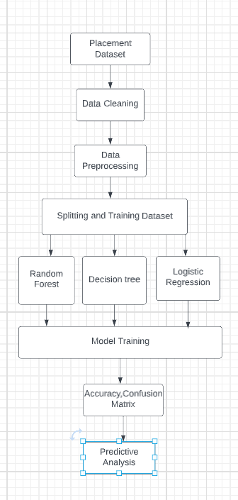
Architecture Diagram

Slide 12
Module one we will be collecting the dataset. The attribute named status is used to tell if the people are placed and not. Outcome value 0 denotes that the student is unplaced and the outcome value 1 denotes that the student is placed
In the Second module, we calculate the number of null values in our dataset. We use pre-processing to clean the dataset so that we get the highest accuracy possible from our model. We also use data pre-processing to remove the duplicate or irrelevant samples and update the missing values with the most relevant values.
In third Module we will be converting all the string values to numbers
In the Fourth Module we will split the dataset into training and testing data using iloc.
Fifth Module is the model in which we will feed the training and testing data into our machine learning model to calculate the accuracy and we find out accuracy for random values.
Sixth Module we use confusion matrix to get a better idea of our model and to get the accuracy

Slide 13
Implementation
Our system predicts if a student would be placed or not based on the student’s qualifications, historical data, and experience. This predictor uses a machine-learning algorithm to give the result
Talking about the dataset, it contains the secondary school percentage, higher secondary school percentage, degree percentage, degree, and work experience of students.
After predicting the result its efficiency is also calculated based on the dataset. The dataset used here is in .csv format

Slide 14
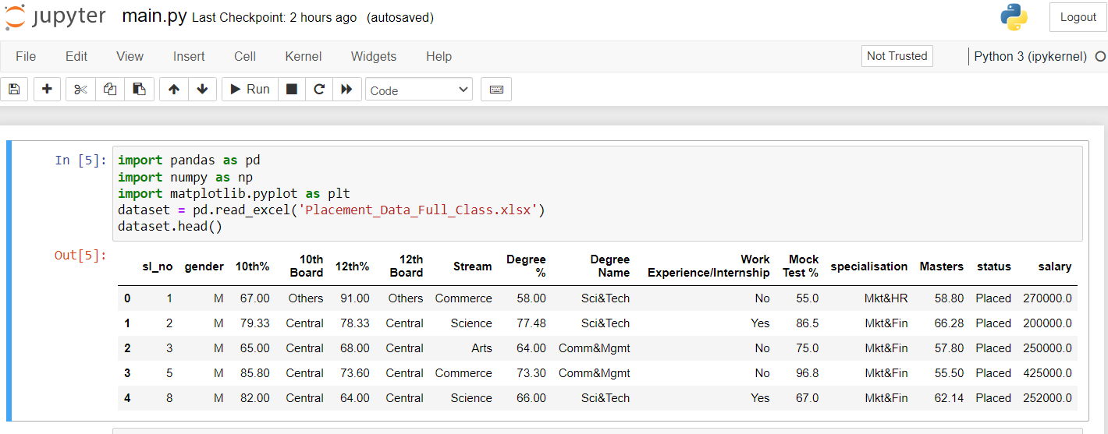
Dataset preparation and pre-processing
Step 1: Import the required modules.
Step 2: Using pd.read_csv to read the dataset

Slide 15
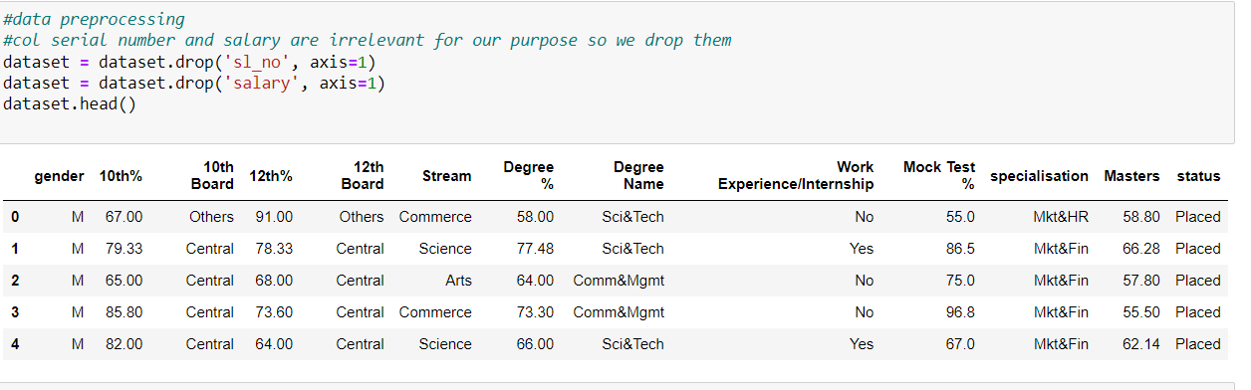
Step 3: Now we will drop the columns that are not needed.

Slide 16
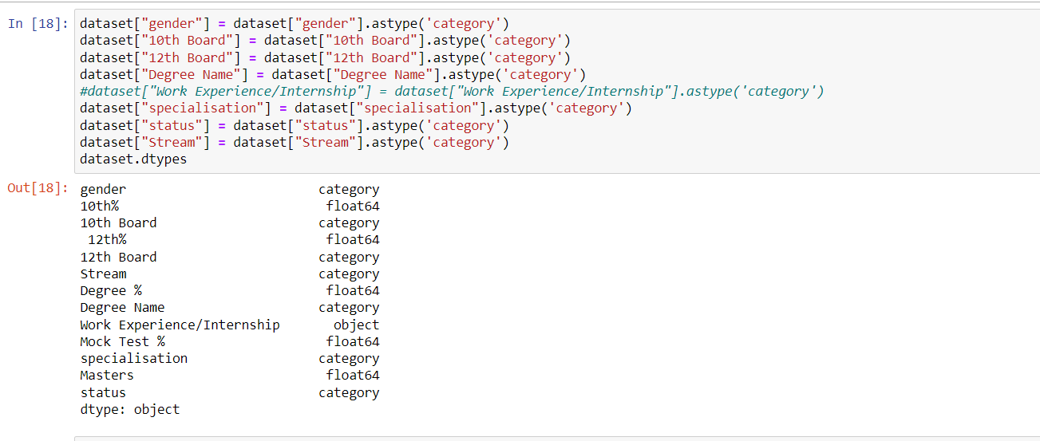
Step 4: Now before moving forward we need to pre-process and transform our data. For that, we will use astype() method on some columns and change the datatype to category.

Slide 17
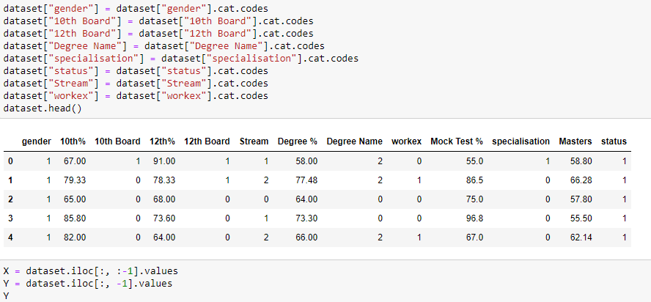
Step 5: Now we will apply codes on some of these columns to convert their text values to numerical values.

Slide 18
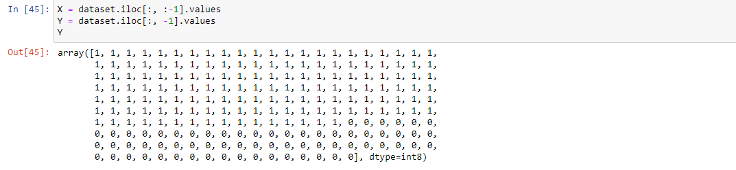
Step 6:Now to split the dataset into features and values using iloc() function

Slide 19
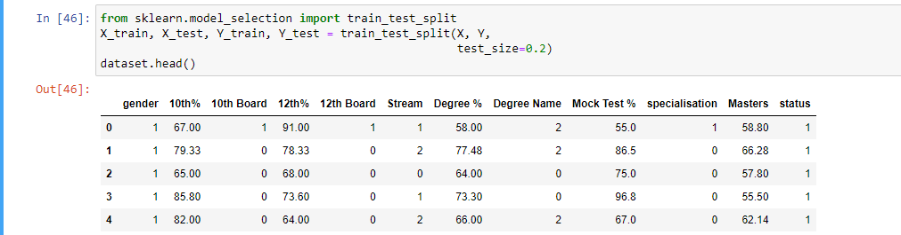
Step 7: Now we will split the dataset into train and test data which will be used to check the efficiency later.

Slide 20
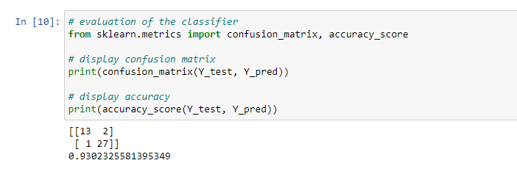
Step 8: Now we need to train our model for which we will need to import a file, and then we will create a classifier using sklearn module. Then we will check the accuracy of the model.

Slide 21

Step 9:Once we have trained the model, we will check it giving some random values:

Slide 22
Step 10: To gain a better understanding of our model’s performance we need to make a confusion matrix. A confusion matrix is a table with two rows and two columns that reports the number of false positives, false negatives, true positives, and true negatives.

Slide 23
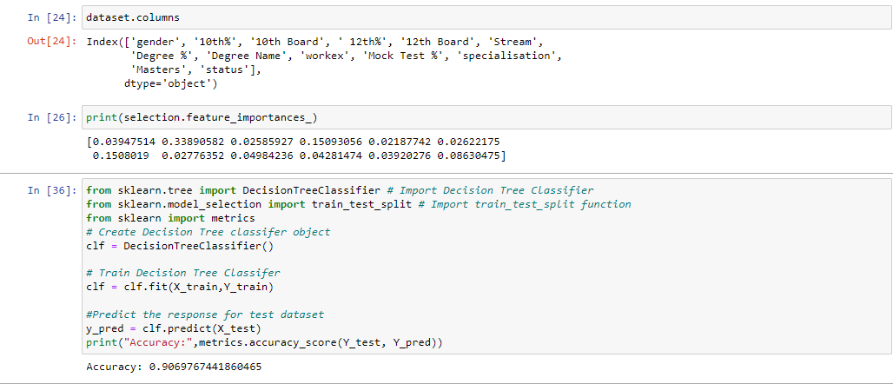
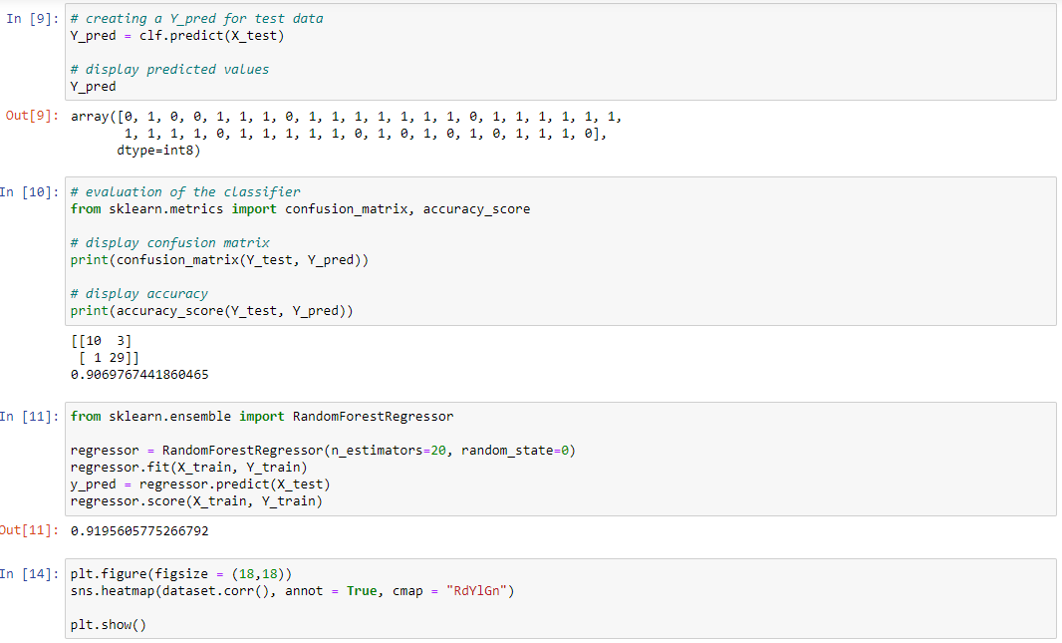
Step 11: We make similar confusion matrix for decision tree and random forest algorithm and compare accuracy

Slide 24
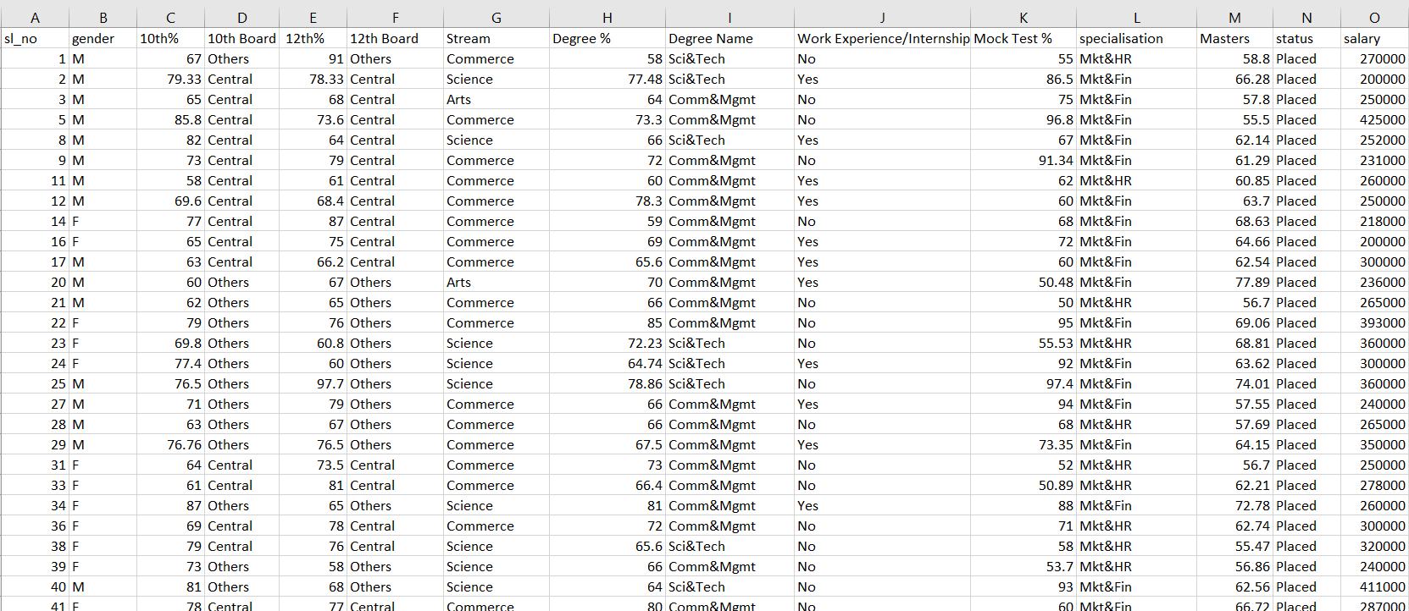
Screenshots

Slide 25
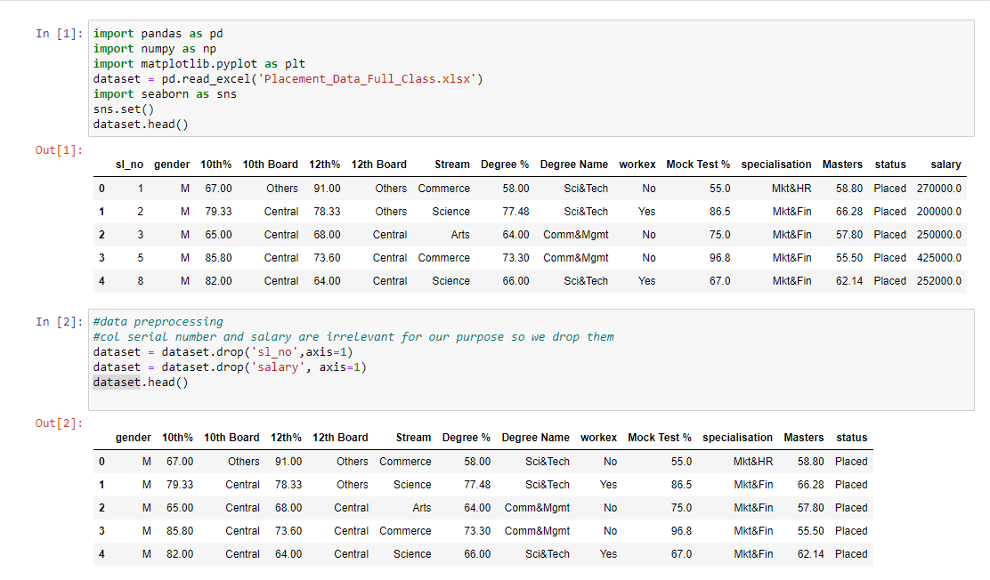

Slide 26
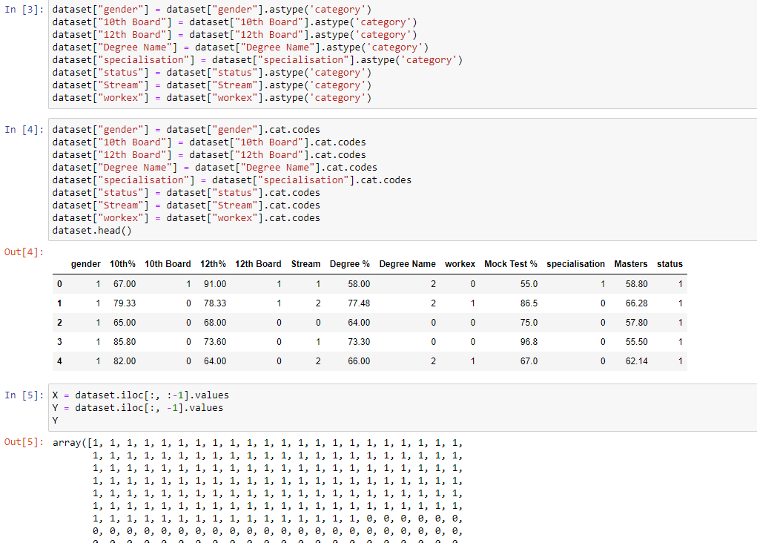

Slide 27
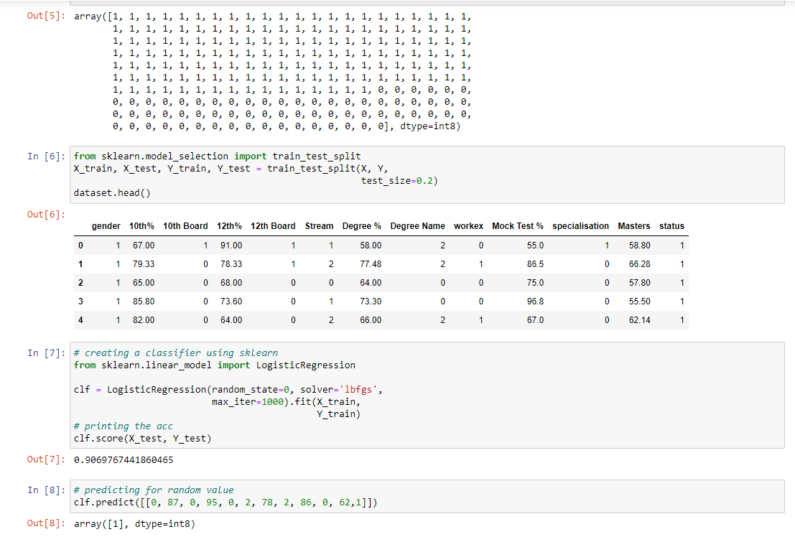

Slide 29
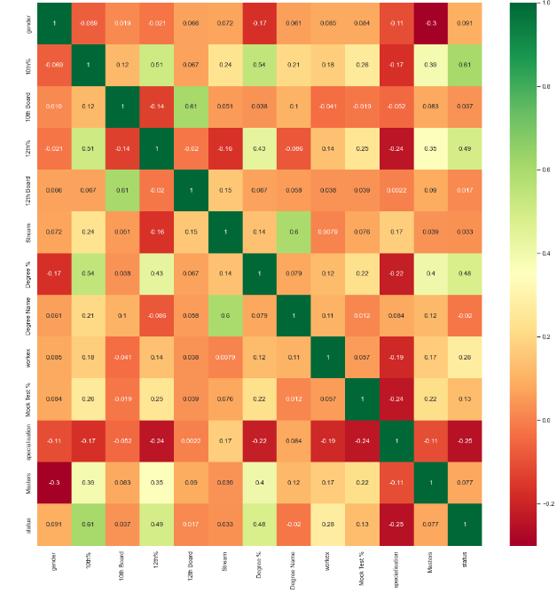

Slide 30
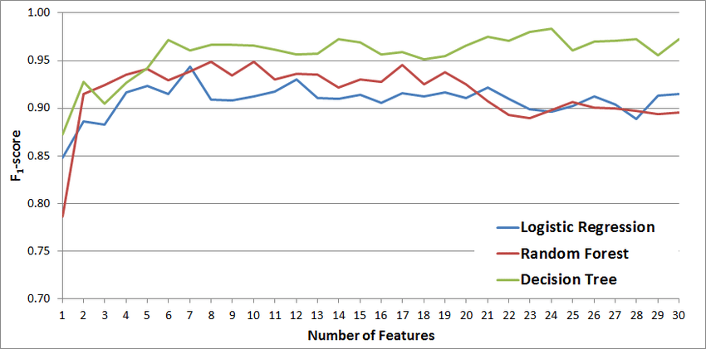

Slide 32
Results & Discussion
We found suitable database that can also measure soft skills.
Did pre-processing, example, one column that was dropped was Salary. While it can be an important column for other projects we do not care about how much the students are making when they are employed we are care about whether they are employed or not.
After that we converted all the string values to numbers and split the dataset into train and test data
After importing the model predicted for random values
To get accuracy made a confusion matrix.
We used various algorithms on our dataset and also compared our results to similar research papers and found that ours was the highest accuracy

Slide 33
References
Saidani, Oumaima, et al. "Predicting Student Employability Through the Internship Context Using Gradient Boosting Models." IEEE Access 10 (2022): 46472-46489.
Moumen, Aniss, et al. "Machine Learning for Students Employability Prediction." (2022).
Premalatha, N., and S. Sujatha. "Optimizable Support Vector Machines To Predict The Students’ Employability Status." Harbin Gongye Daxue Xuebao/Journal of Harbin Institute of Technology 54.5 (2022): 51-60.
Srivastava, Vishal, et al. "Modelling student employability on an academic basis: A supervised machine learning approach with R." Handbook of Research on Innovative Management Using AI in Industry 5.0. IGI Global, 2022. 179-191.
Panityakul, Thammarat, et al. "Classification models for employability of statistics and related fields graduates from Thailand universities." Computer Science 17.1 (2022): 365-375.

Slide 34
Piad, Keno C., et al. "Predicting IT employability using data mining techniques." 2016 Third International Conference on Digital Information Processing, Data Mining, and Wireless Communications (DIPDMWC). IEEE, 2016.
Maaliw, Renato R., et al. "Employability Prediction of Engineering Graduates Using Ensemble Classification Modeling." 2022 IEEE 12th Annual Computing and Communication Workshop and Conference (CCWC). IEEE, 2022.
Ambili, P. S., and Biku Abraham. "A Predictive Model for Student Employability Using Deep Learning Techniques." ECS Transactions 107.1 (2022): 10149.
Usita, Maricris M. "Graduates Employability Analysis using Classification Model: A Data Mining Approach." Journal of Positive School Psychology 6.3 (2022): 2788-2796.

Slide 35
Saouabi, Mohamed, and Abdellah Ezzati. "Toward a Prescriptive Analysis in Machine Learning: Use Case of Employability in Morocco." International Conference on Electrical Systems & Automation. Springer, Singapore, 2022.
Ng, Peggy ML, Tai Ming Wut, and Jason KY Chan. "Enhancing perceived employability through work-integrated learning." Education+ Training ahead-of-print (2022).
Shava, Herring. "Linear Predictors of Perceived Graduate Employability among South Africa’s Rural Universities’ Learners during the Covid-19 Pandemic." International Journal of Learning, Teaching and Educational Research 21.3 (2022).
Hossain, Md Shamim, Mst Farjana Rahman, and Md Kutub Uddin. "Analyzing and Predicting Learner Sentiment Toward Specialty Schools Using Machine Learning Techniques." Applying Data Science and Learning Analytics Throughout a Learner’s Lifespan. IGI Global, 2022. 133-158.

Slide 36
THANK YOU

